Slide 1
Game Playing:
MinMax and Alpha Beta Pruning

Slide 2
Game Playing
A game is a sequence of alternating moves between two individual players or two groups of players with the objective of achieving a predetermined goal. The player achieving the goal is said to WIN the game.
Examples:
  Individual players:
    Tic-Tac-Toe
    Chess
  Groups of players
    Cricket
    Football

Slide 3
Game Tree
A Game Tree is a tree which has a root representing a particular move which can be played by a player A under the current state of the game.
The player trying to win the game attempts to maximize his advantage and thus his chances of winning or to minimize the cost which will be incurred by him if he plays a particular move.
The player A checks whether the move he is going to play next will be an advantageous move or not by looking ahead from the current state of the game by constructing a separate game tree for each possible move that he can play. He then selects the move which gives him the maximum advantage.

Slide 4
Minimax Search Procedure
Minimax is a two-pass search, one pass is used to assign heuristic values to the nodes at the ply depth and the second is used to propagate the values up the tree.
In a two player game, the first player moves with MAX score and the second player moves with MIN score.
A minimax search is used to determine all possible continuations of the game up to a desired level.
A score is originally assigned to the leaf, then by evaluating each possible set of moves, a score is assigned to the upper level by the minimax algorithm. The minimax algorithm performs a preorder traversal and computes the scores on the ply.

Slide 5
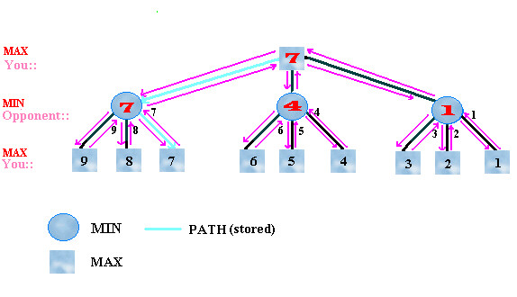
Minimax Search: A Game Tree

Slide 6
Alpha Beta Cutoffs
Alpha-beta pruning is a search algorithm which seeks to reduce the number of nodes that are evaluated in the search tree by the minimax algorithm.
Alpha-beta search proceeds in a depth-first fashion.
An alpha value is an initial or temporary value associated with a MAX node. Because MAX nodes are given the maximum value among their children, an alpha value can never decrease; it can only go up. In a MAX node, alpha is updated.
A beta value is an initial or temporary value associated with a MIN node. Because MIN nodes are given the minimum value among their children, a beta value can never increase; it can only go down. In a MIN node, beta is updated.

Slide 7
Alpha Pruning
Suppose a MAX node's alpha = 6. Then the search needn't consider any branches issued from a MIN descendant that has a beta value that is less-than-or-equal to 6. So if you know that a MAX node has an alpha of 6, and you know that one of its MIN descendants has a beta that is less than or equal to 6, you needn't search any further below that MIN node. This is called alpha pruning.
The reason is that no matter what happens below that MIN node, it cannot take on a value that is greater than 6. So its value cannot be propagated up to its MAX (alpha) parent.

Slide 8
Beta Pruning
If a MIN node's beta value = 6, you needn't search any further below a descendant MAX that has acquired an alpha value of 6 or more. This is called beta pruning.
The reason again is that no matter what happens below that MAX node, it cannot take on a value that is less than 6. So its value cannot be propagated up to its MIN (beta) parent.

Slide 9
Rules of Alpha Beta Pruning
Alpha Pruning: Search can be stopped below any MIN node having a beta value less than or equal to the alpha value of any of its MAX ancestors.
Beta Pruning: Search can be stopped below any MAX node having a alpha value greater than or equal to the beta value of any of its MIN ancestors.

Slide 10
Pruning: Summary
Ancestor | Descendant | Condition | Outcome
Max (Alpha) | Min(Beta) subtree | Beta of MIN subtree<=Alpha of MAX Ancestor | Alpha pruning Prune descendant subtree
C, Alpha =3 | D, Beta = 0 | Beta(0)<Alpha(3) | Alpha pruning
Min (Beta) | Max(Alpha) subtree | Alpha of MAX subtree>= Beta of MIN Ancestor | Beta pruning Prune descendant subtree
A, Beta=3 | B, Alpha = 5 | Alpha(5)> Beta(3) | Beta pruning
Rule of thumb: Alpha should be greater than beta for pruning.

Slide 11
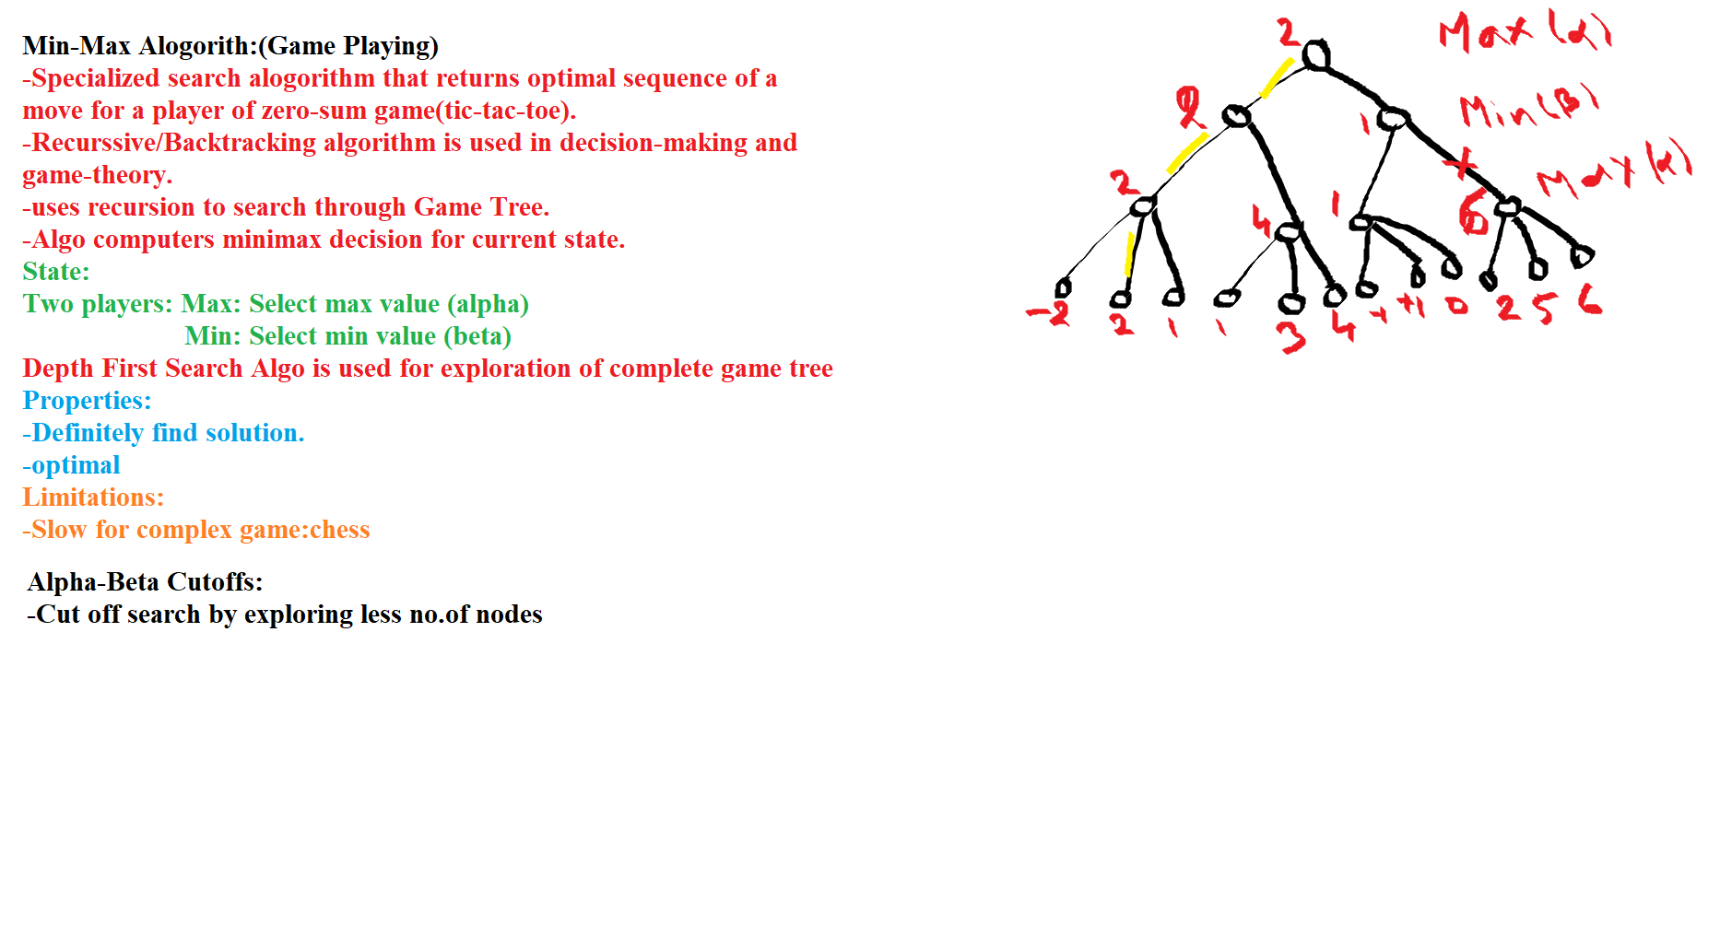

Slide 12
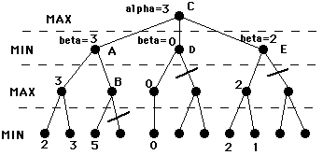
Left to Right Alpha-Beta Prune

